Slide 1

Rajkiya Engineering College banda
Mini Project
Diabetes Prediction System Using Machine Learning
Guided by. Presented By
Mr. Shantanu Shukla Yash Saxena
Mr. Sandip Kr. Singh Nikita Kabir
Mr. Abhishek Kr. Yadav Sandeep Kumar
Akash Kumar

Slide 2
Objective
Design a Diabetes Prediction System Using Machine Learning , HTML , CSS and Flask.
Problem Statement
Patients with the potential of diabetes have to go through a series of tests and exams to
diagnose the disease properly. These tests might embody redundant or inessential medical procedures, that cause complications and wastage of time and resources.

Slide 3
Introduction
All around there are numerous ceaseless infections that are boundless in evolved and developing nations. One of such sickness is diabetes. Diabetes is a metabolic issue that causes blood sugar by creating a significant measure of insulin in the human body or by producing a little measure of insulin. Diabetes is perhaps the deadliest sickness on the planet. It is not just a malady yet, also a maker of different sorts of sicknesses like a coronary failure, visual deficiency, kidney ailments and nerve harm, and so on.
Type 1 diabetes means that the immune system is compromised and the cells fail to produce insulin in sufficient amounts.
Type 2 diabetes means that the cells produce a low quantity of insulin or the body can’t use the insulin correctly.

Slide 4
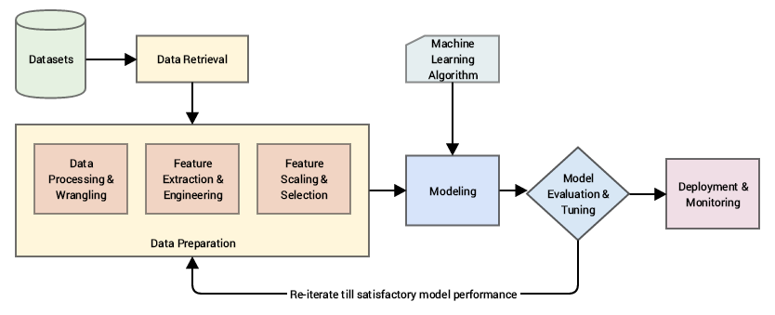
Flowchart of the Model

Slide 5
1 - Data Set
The dataset collected is originally from the Pima Indians Diabetes Database is available on Kaggle. It consists of several medical analyst variables and one target variable.
Serial no | Attribute Names | Description
1 | Pregnancies | Number of times pregnant
2 | Glucose | Plasma glucose concentration
3 | Blood Pressure | Diastolic blood pressure
4 | Skin Thickness | Triceps skin fold thickness (mm)
5 | Insulin | 2-h serum insulin
6 | BMI | Body mass index
7 | Diabetes pedigree function | Diabetes pedigree function
8 | Outcome | Class variable (0 or 1)
9 | Age | Age of patient

Slide 6
2 - Data Pre-Processing
This phase of model handles inconsistent data in order to get more accurate and precise results like in this dataset Id is inconsistent so we dropped the feature. This dataset doesn’t contain missing values. So, we imputed missing values for few selected attributes like Glucose level, Blood Pressure, Skin Thickness, BMI and Age because these attributes cannot have values zero. Then data was scaled using Standard Scaler. Since there were a smaller number of features and important for prediction so no feature selection was done.

Slide 7
3 - Missing value identification
Attributes Name | NULL Values
Pregnancies | 0
Glucose | 0
Blood Pressure | 0
Skin Thickness | 0
Insulin | 0
BMI | 0
Diabetes Pedigree Function | 0
Age | 0
Outcome | 0

Slide 8
4 - Feature selection
Attributes | Correlation with Outcome(Target variable)
Glucose | 0.466581
BMI | 0.292695
Age | 0.238356
Pregnancies | 0.221898
Diabetes Pedigree Function | 0.173844
Insulin | 0.130548
Skin Thickness | 0.074752
Blood Pressure | 0.065068

Slide 9
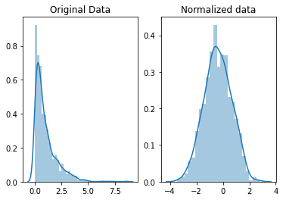
5 - Scaling and Normalization
We performed feature scaling by normalizing the data from 0 to 1 range, which boosted the algorithm’s calculation speed. Scaling means that you're trans forming your data so that it fits within a specific scale, like 0- 100 or 0-1. You want to scale d ata when you're using methods based on measures of how far apart data points are, like support vector machines (SVM). With these algorithms, a change of "1" in any numeric feature is given the same importance.

Slide 10
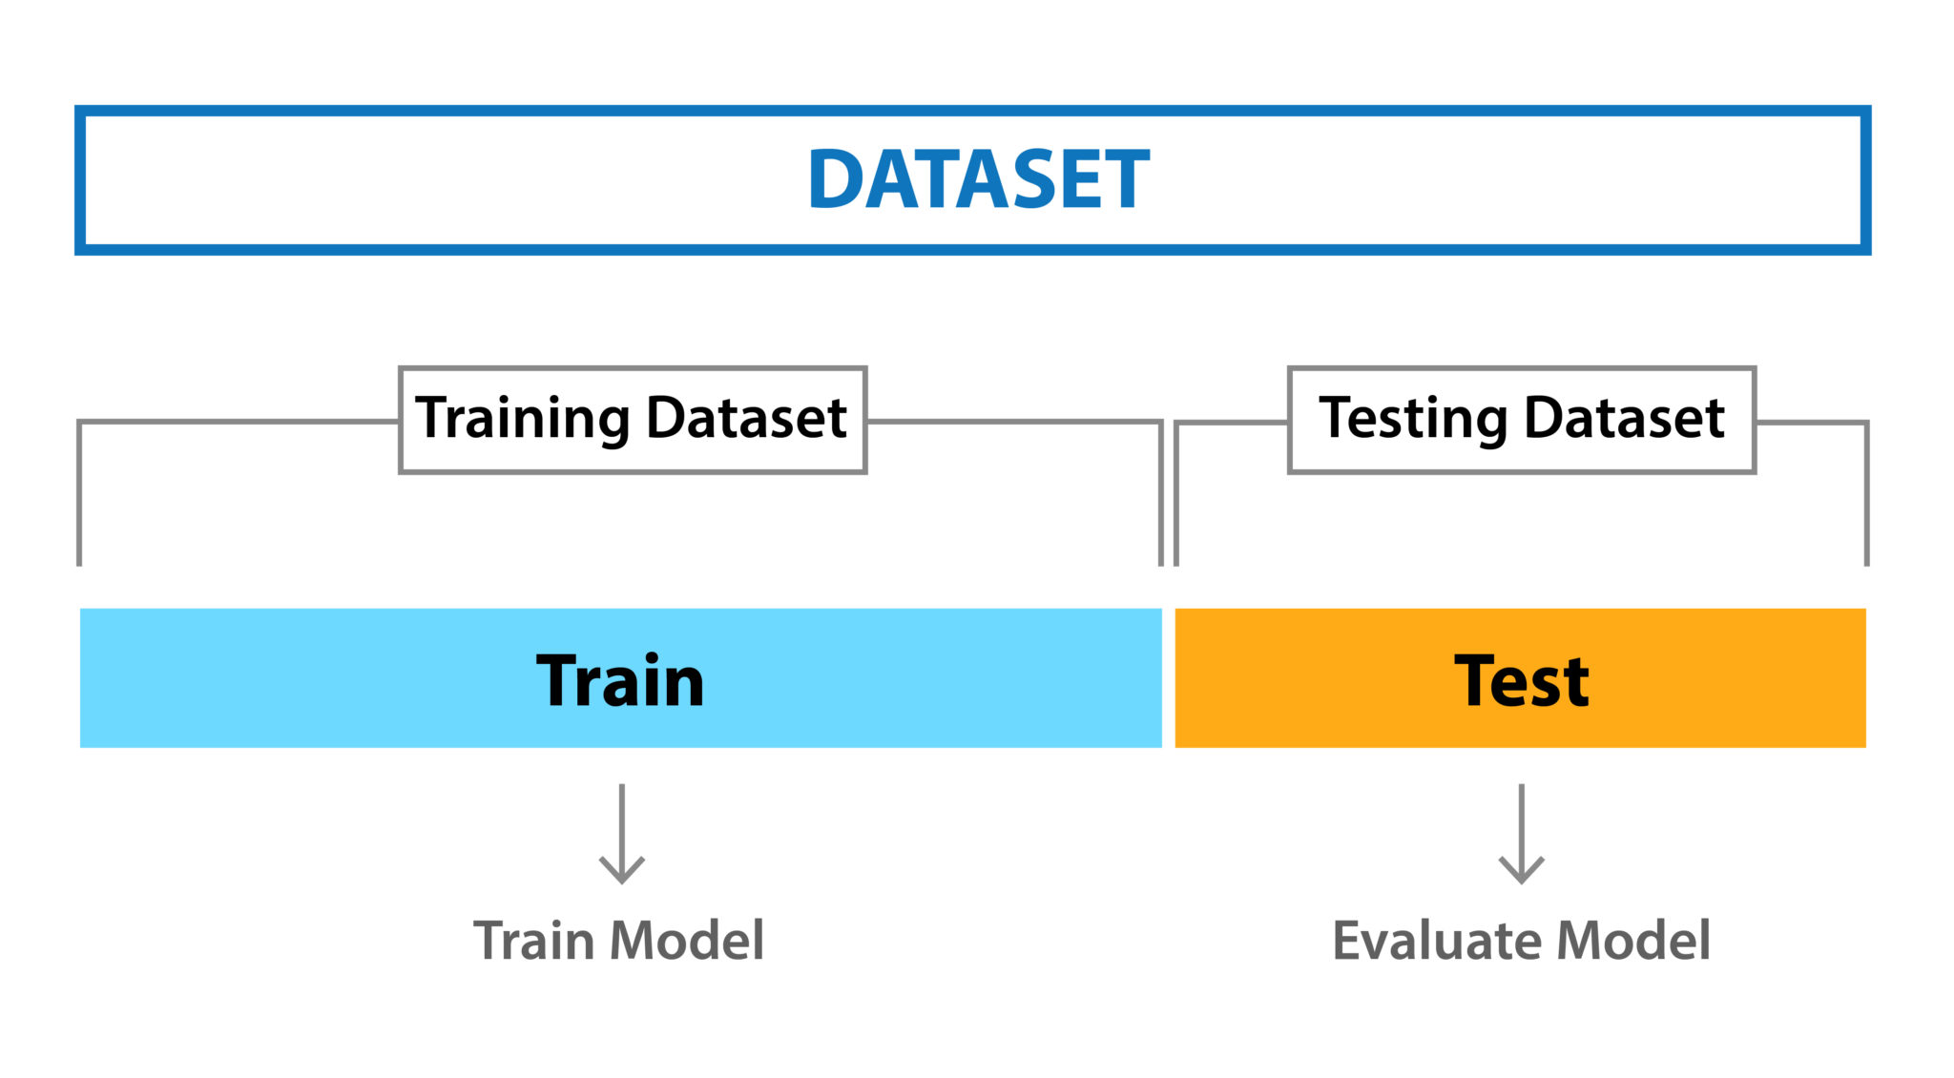
6 - Splitting of data

Slide 11
7 - Design and implementation of classification model
In this research work, comprehensive studies are done by applying different ML classification techniques like Decision Tree, Random Forest, Logistic Regression, Support Vector Machine.
Logistic Regression: Logistic regression is a machine learning technique used when dependent variables are able to categorize. The outputs obtained by using the logistic regression is based on the available features. Here sigmoidal function is used to categorize the output.
SVM: SVM is supervised learning algorithm used for classification. In SVM we have to identify the right hyper plane to classify the data correctly. In this we have to set correct parameters values. To find the right hyper plane we have to find right margin for this we have choose the gamma value as 0.0001 and rbf kernel. If we select the hyper plane with low margin leads to miss classification.

Slide 12
Decision Tree: Decision tree is non parametric classifier in supervised learning. In this method all the details are represented in the form of tree, where leaves are corresponds to the class labels and attributes are corresponds to internal node of the tree. We have used Information Gain for splitting the nodes
Random Forest: Random Forest is an ensemble learning method for classification. This algorithm consists of trees and the number of tree structures present in the data is used to predict the accuracy. Where leaves are corresponds to the class labels and attributes are corresponds to internal node of the tree. Here number of trees in forest used is 100 in number and Information Gain is used for splitting the nodes.

Slide 13
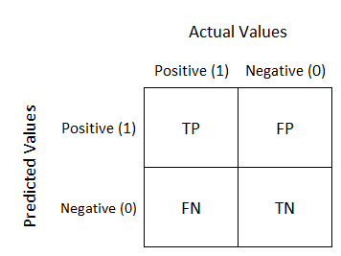
8 - Measurements
To find the efficient classifier for diabetes prediction we have applied a performance matrices are confusion matrix and accuracy.
Confusion Matrix :
Accuracy : Number of correct Prediction
Total numbers of predictions made

Slide 14
9 – RESULTS
Machine Learning Algorithms | Error (Root mean square error)
Logistic Regression | 0.47846366201788553
Decision Tree | 0.5542214735280918
Random Forest | 0.48658978444889833
Support Vector Machine | 0.4715113977918053

Slide 15
10 - Creating a User Interface for Accessibility
The last part of the project is the creation of a user interface for the model. This user interface is used to enter unseen data for the model to read and then make a prediction. The user interface is created using
1- Flask
2 - Hyper Text Markup Language
3 - Cascading Style Sheets

Slide 16
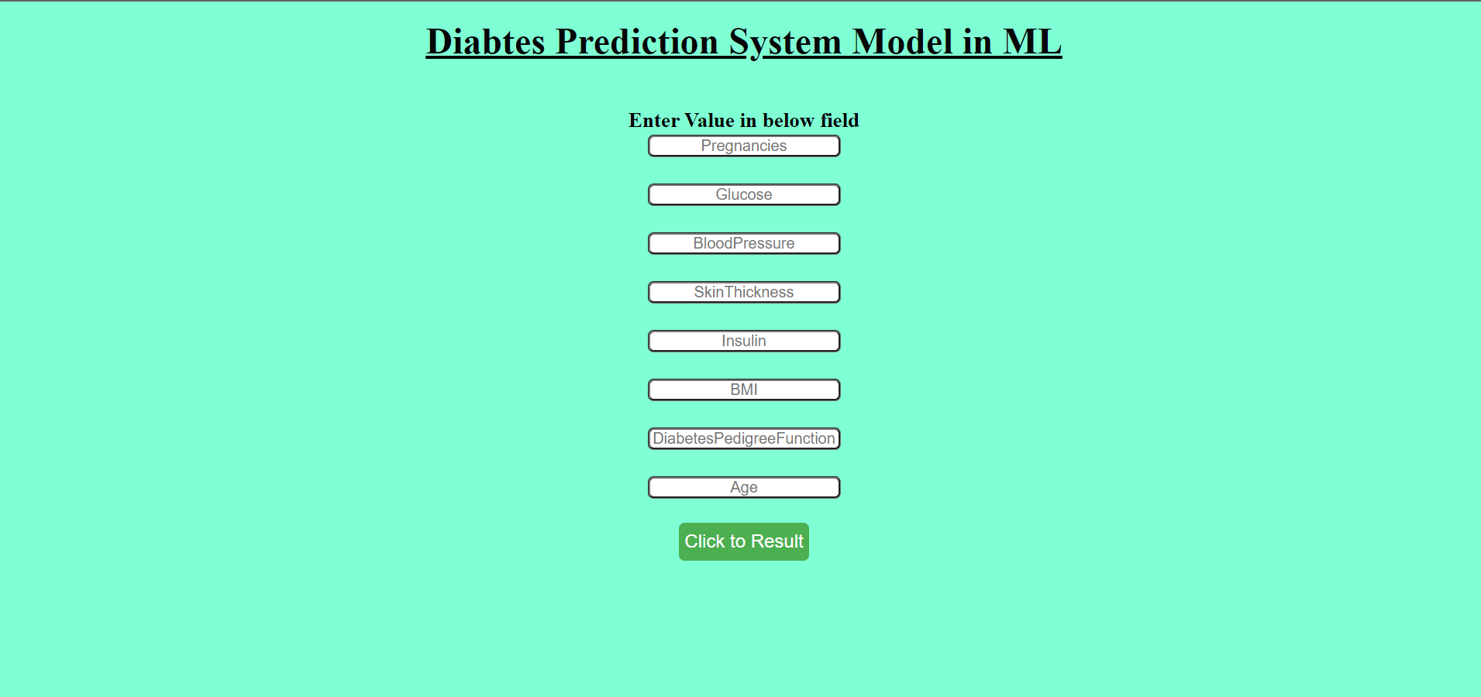

Slide 17
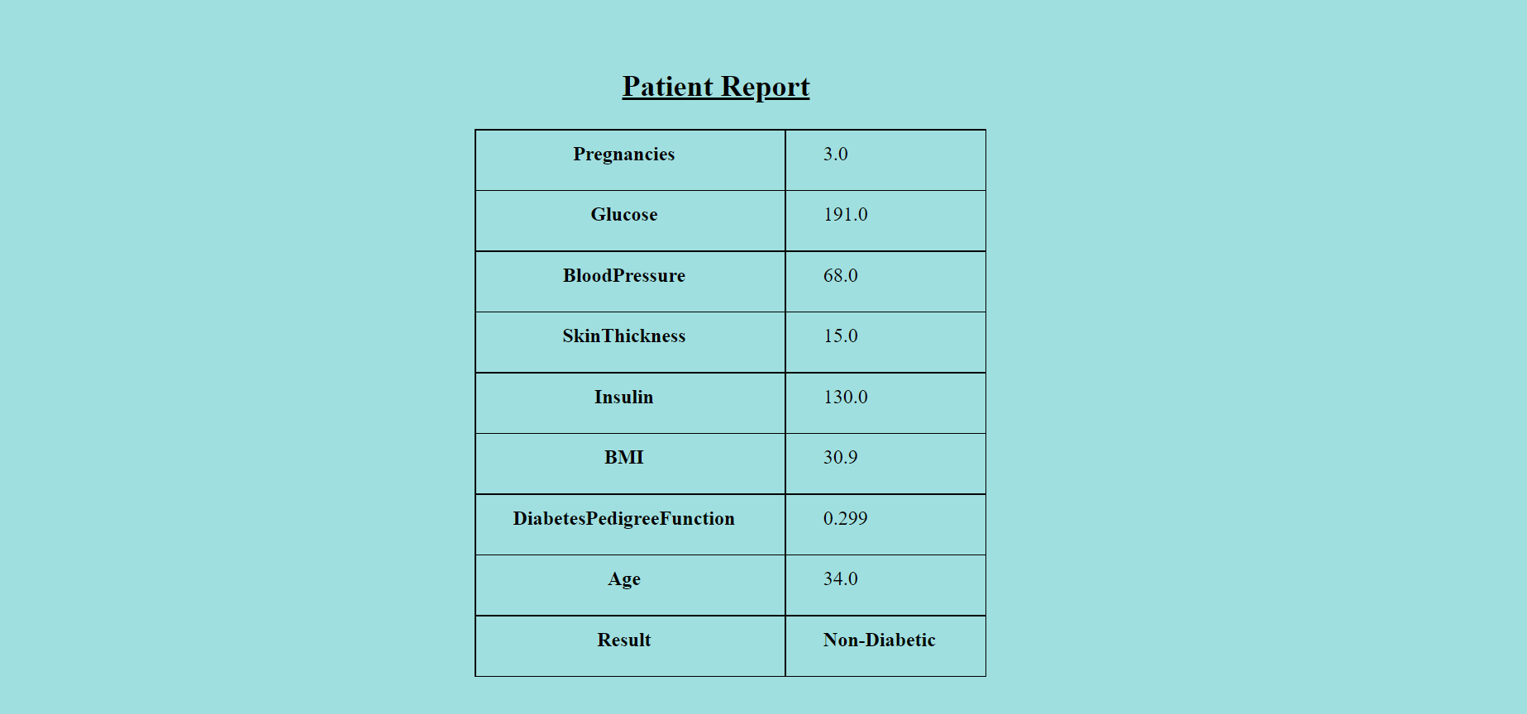

Slide 18
Conclusion
The main aim of this project was to develop a model which could identify patients with diabetes who are at high risk of hospital admission.

Slide 19
Thank you

